Slide 1
Towards Open-Source Models of Cryogenic CMOS
Brian Hoskins and Pragya Shrestha
National Institute of Standards and Technology, MD, USA
April 19, 2022

Slide 2

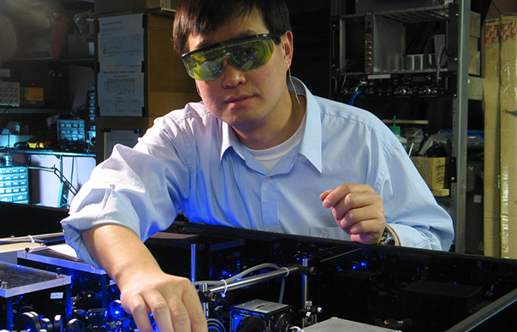
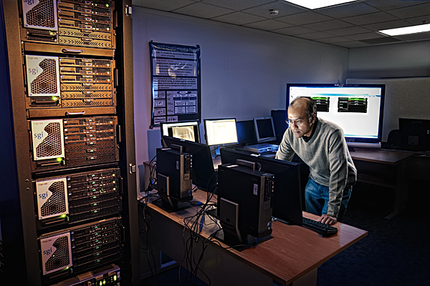
NIST Mission
To promote U.S. innovation and industrial competitiveness by advancing measurement science, standards, and technology in ways that enhance economic security and improve our quality of life
a
©Robert Rathe
Credit: J.Burrus/NIST
©Nicholas McIntosh Photography

Slide 3

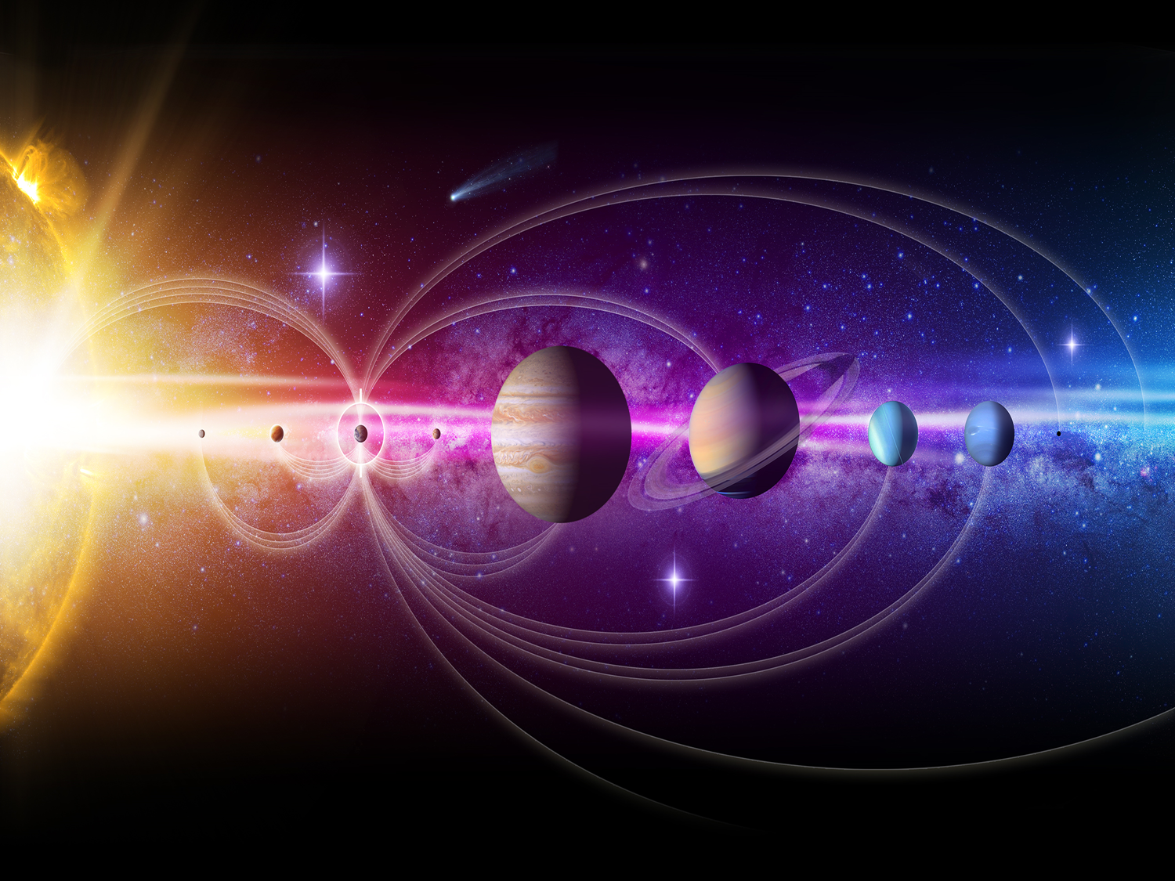
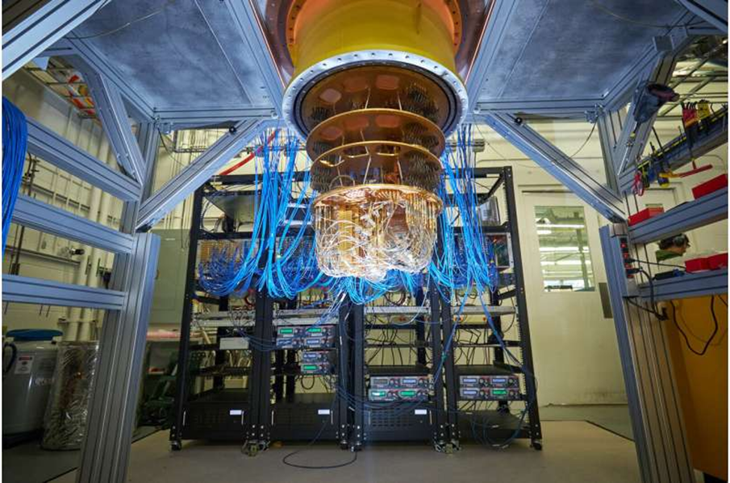
Cryogenic Electronics : Applications
High Performance Computing
LT Source/Sensor Electronics
Supercomputer : 77 K
Quantum Computing
e.g., opto-electronics
Quantum computer: < 20 mK

Slide 4
High Performance Computing
Speed
High mobility, higher saturation velocity
Lower noise
Better reliability
lower thermally assisted degradations
Reduced susceptibility to latch-up
Increased integration density due to higher thermal conductivity of materials used in circuits
Less power consumption due to lower supply voltage
Gutierrez-D et all Low temperature electronics : physics, devices, circuits, and applications, 2001; Balestra, F. Et al, Device and circuit cryogenic operation for low temperature electronics, 2001.
Notes:
Other parameters

Slide 5
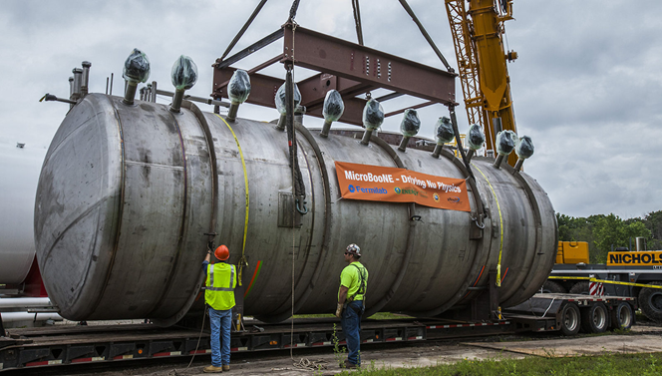
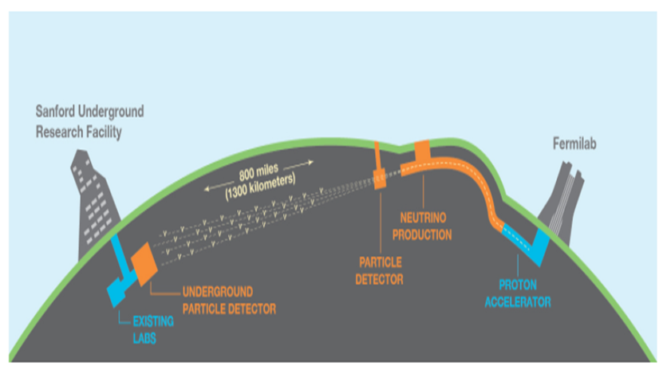
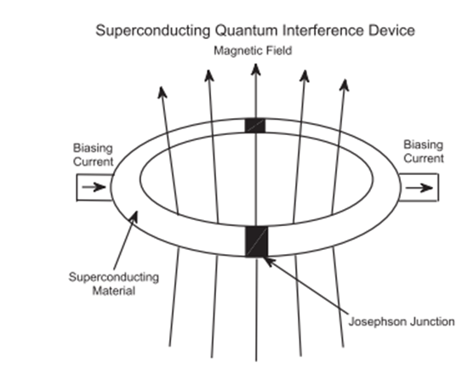
Low Temperature Sensor Electronics
Satellite
Space mission
Dark matter physics
Magnetometry
Measuring tiny magnetic fields
Gravitational wave research
Sensors operated at low temperatures
Due to environment
To improve sensitivity
Low temperature required for it to work
Gutierrez-D et all Low temperature electronics : physics, devices, circuits, and applications, 2001
Notes:
Usually, these sensors are operated at low temperatures either
to improve sensitivity, or
due to environment, it is being operated at or
these sensors may require to be at low temp for it to work

Slide 6
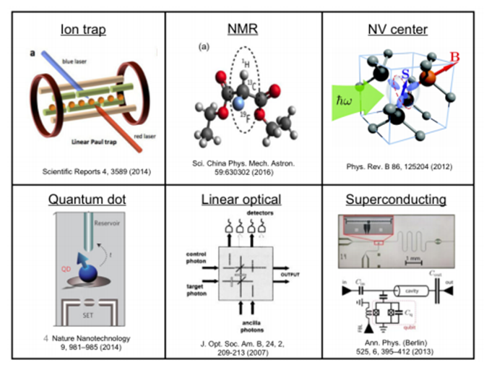
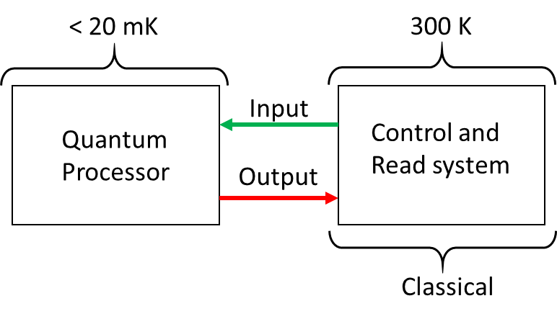
Control Electronics for Quantum Computers
300 K
Digital Control
ASIC/FPGA
1 - 4 K
ADC
DAC
Quantum computer: < 20 mK
Read
OSC
Amp
Mix of AC and DC signal required to control and read the Qubits
Digital
Inverters, ring oscillators
Analog
Voltage reference, Low Noise Amplifiers
Control
MUX
DEMUX
<100 mK
Quantum processor
https://phys.org/news/2020-08-google-largest-chemical-simulation-quantum.html ; https://www.cnet.com/news/google-quantum-supremacy-only-first-taste-of-computing-revolution, Amundson, J.; Sexton-Kennedy, E. J. E. W. C., Quantum Computing. 2019

Slide 7
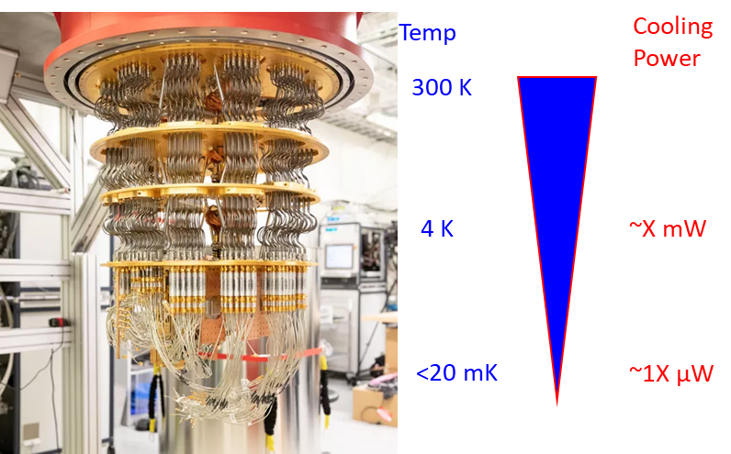
Requirement of Low Operating Power
Low power operation
300 K
Digital Control
ASIC/FPGA
1 - 4 K
ADC
DAC
Read
OSC
Amp
Control
MUX
DEMUX
<100 mK
Quantum processor

Slide 8
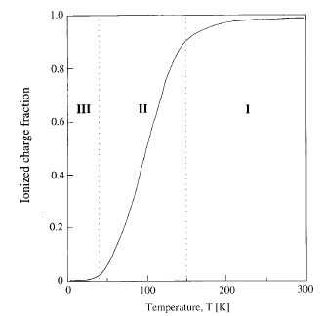
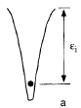
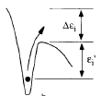
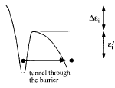
Device at Low Temperature
Do devices work at low temperatures?
YES!!! Devices function at cryogenic temps (4 K)
MOSFETs
In general: |V_{th}|increases, I_{ON} increases (mobility), and SS improves
10 x 0.36 μm² Si/SiO₂ (4 nm)
Gutierrez-D et all Low temperature electronics : physics, devices, circuits, and applications, 2001

Slide 9
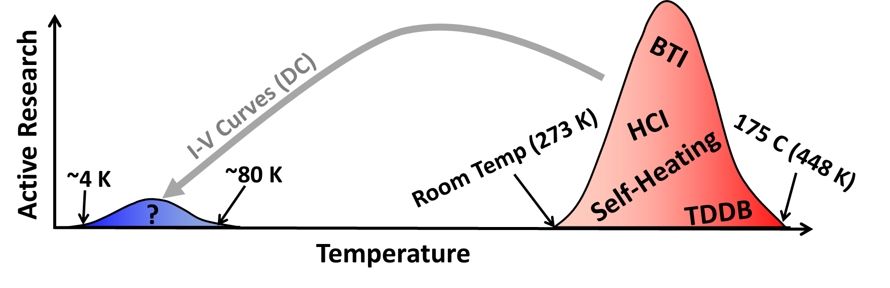



Problem?
RT | ~4K
Device Models | Device Model
Reliability | Reliability
Device Physics | Device Physics

Slide 10
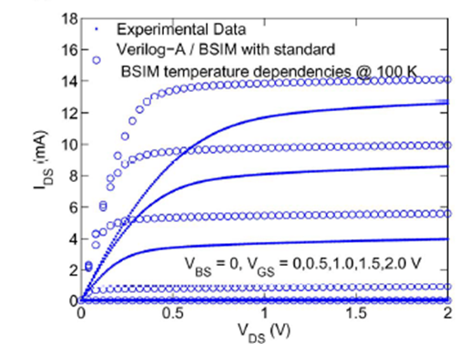
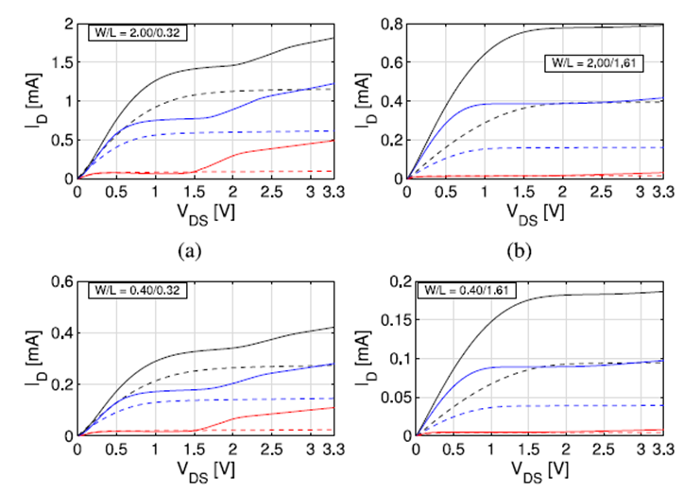
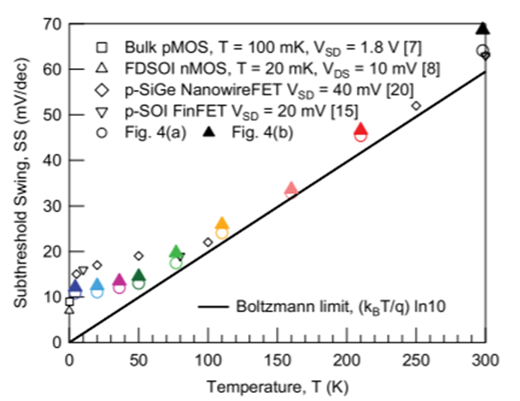

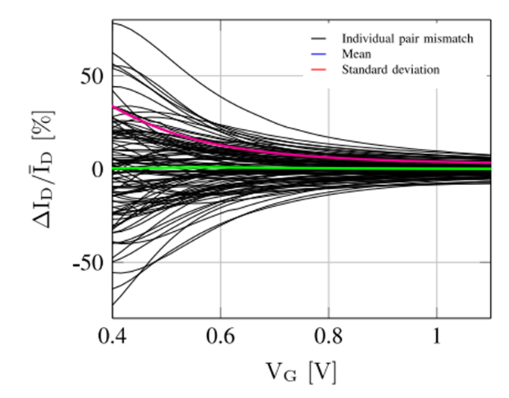
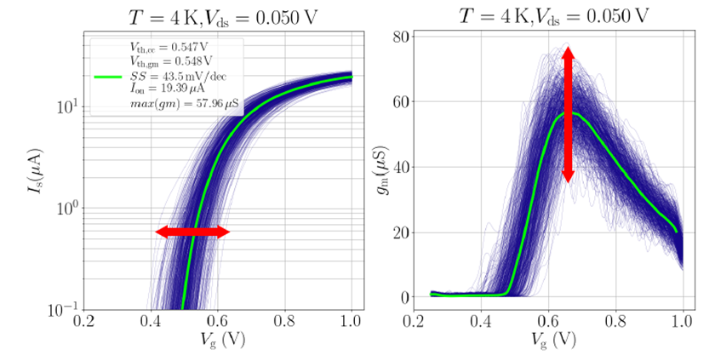
Proper Device Characterization for Accurate PDK
Cryo-CMOS models
Build device model
Necessary for circuit design
Commercial device model
Down to 233 K ( - 40 ⁰C)
Does not account for
Kink effect
SS saturation
Accurate transistor mismatch and variability
Incomplete ionization mechanism
Low temperature noise effects
Understanding device physics
Extrapolating parameters
Down selecting relevant technologies
Account for reliability issues
Akturk, A. et al, TED 2010; Beckers, A. et al JEDS 2018; Hart, P. A. T. et al, JEDS 2020, Grill, A. et al, 2020 IEEE International Reliability Physics Symposium (IRPS)

Slide 11
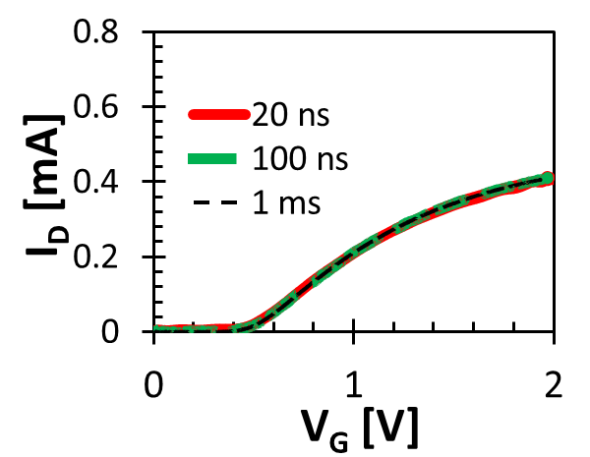
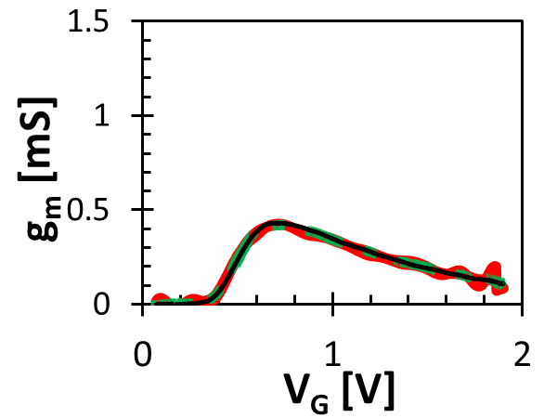
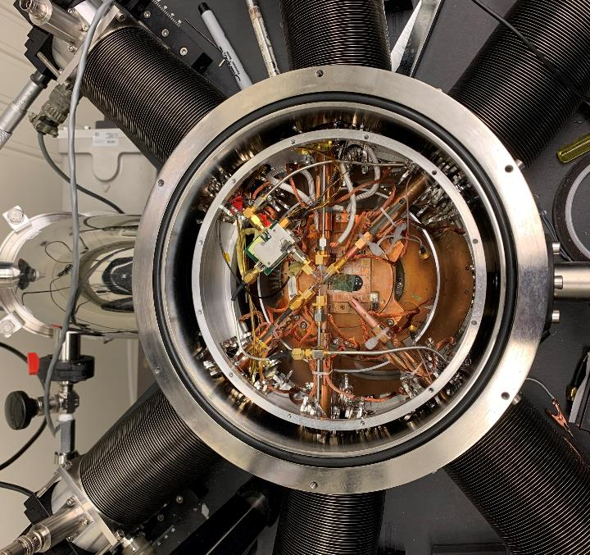
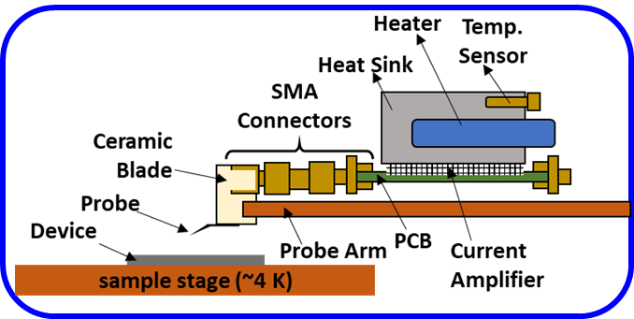
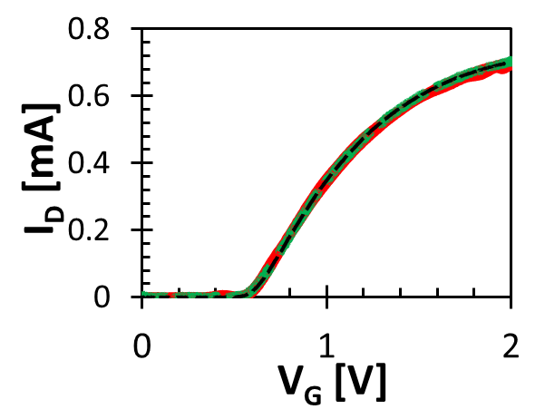
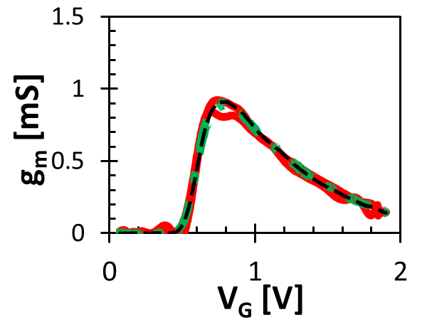
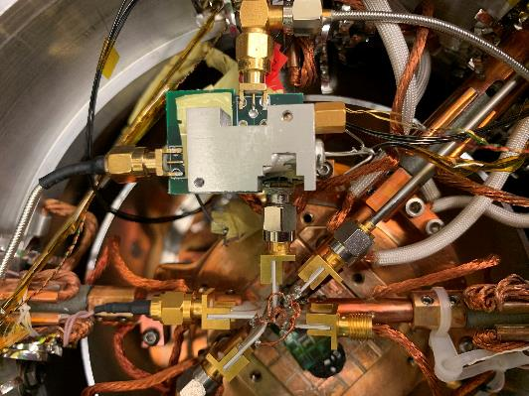
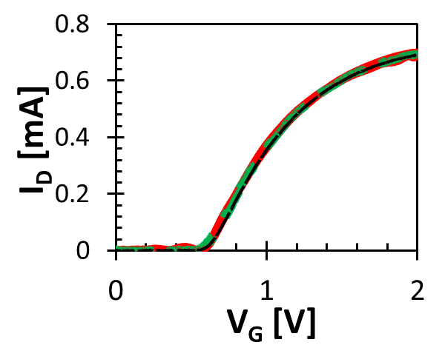
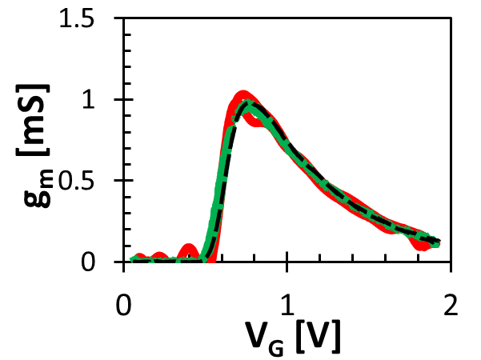
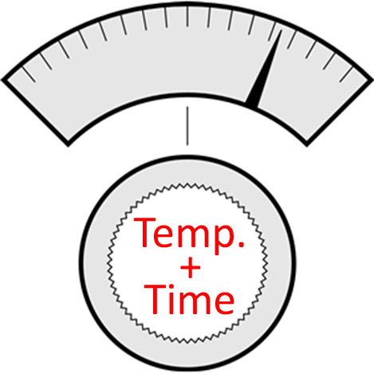
Cryogenic Fast IV Setup for Device Reliability and Physics Measurements
Time + Temperature dependent characterization
300 K
300 K
Amplifier
80 K
80 K
8 K
8 K
Heat sink
Heater
Temp. probe
P. R. Shrestha et. al (submitted JEDS)

Slide 12
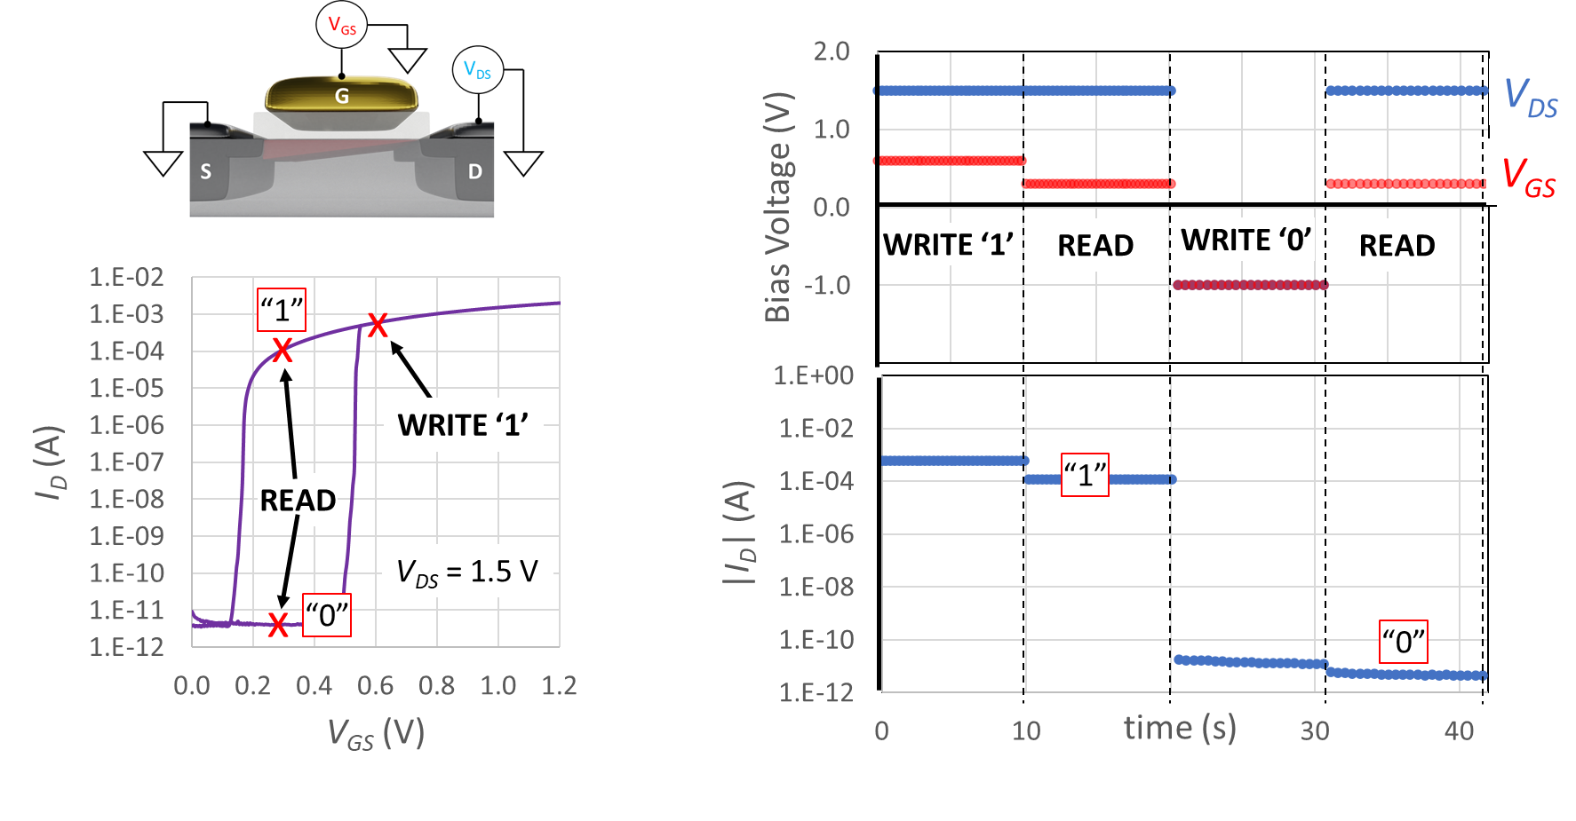
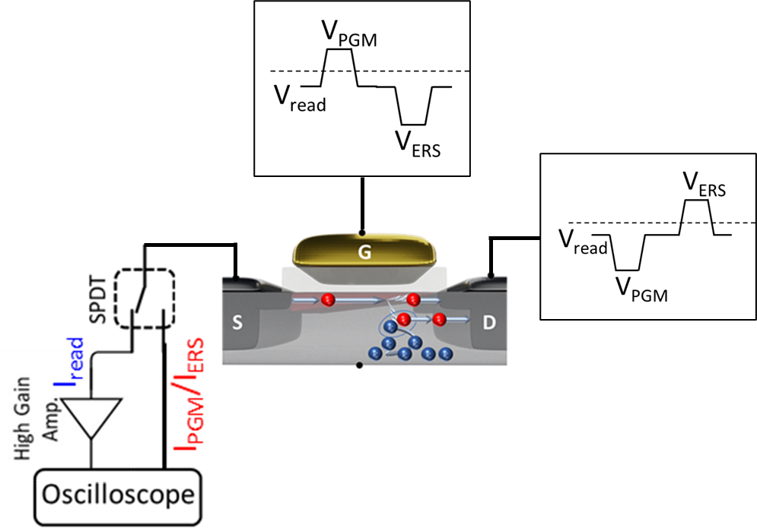
Low Temperature Device Characterization Setup : Memory
Zaslavsky et al. APL 2021; Richter et al. APS 2022.

Slide 13
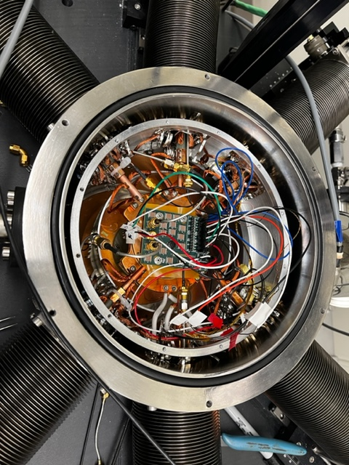
Low Temperature Circuits Characterization
Setup
Temperature dependence (multi temp. measurements)
Special board layout
On board temperature sensor
CMOS Circuit (Collective Pulse Oscillators)
Noise
Power
Frequency
Reliable Time + Temperature Measurement
Prashansa Mukim, Jabez McClelland.

Slide 14


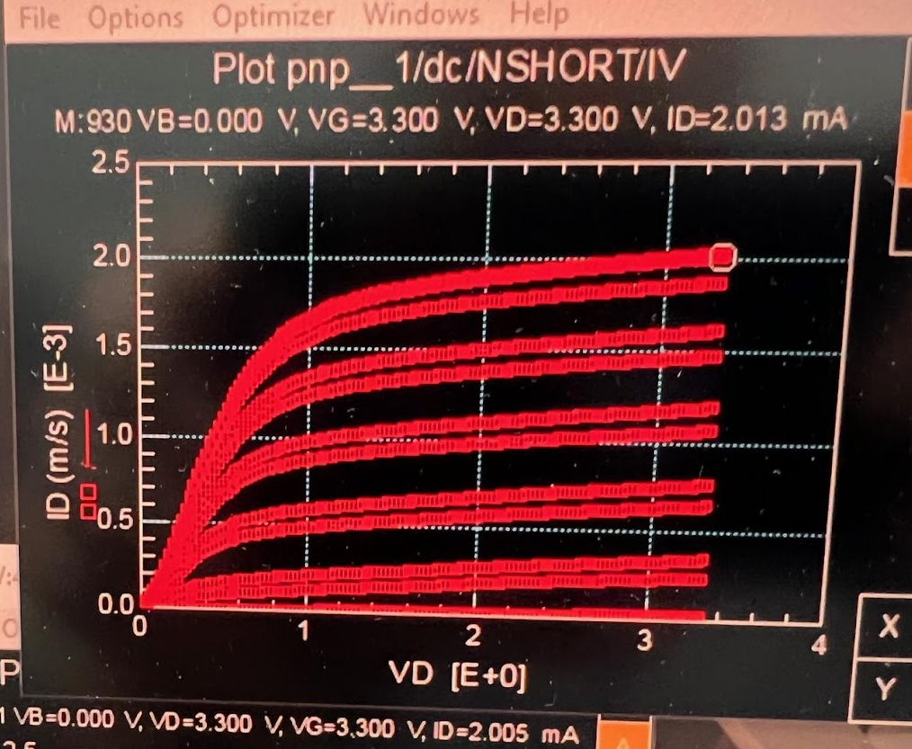
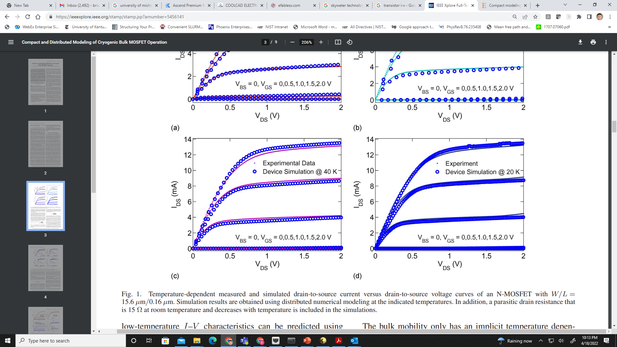




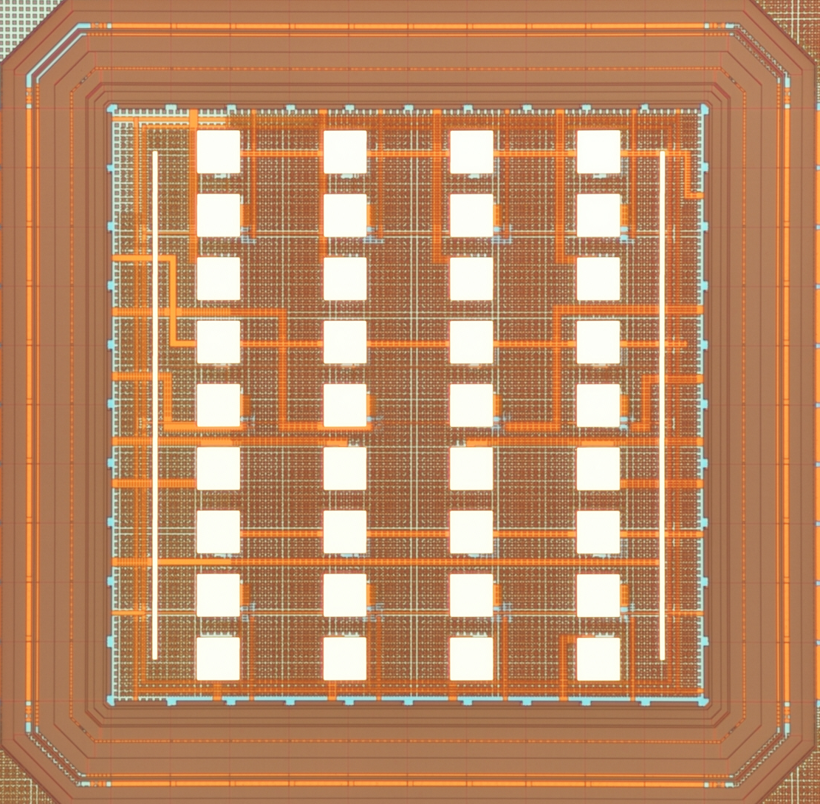
Partners and Plan
Cryogenic Models and Data of Open Sky130
Raw Data
Fit Models
Useful Devices
Si-Proven IP@4k
Mehdi Saligane, Tuohang Zeng, David Fleischer, Akin Akturk, Advait Madhavan, Tim Edwards, Jeff DiCorpo, Tim Ansell, Ethan Mahintorabi, Aaron Cunningham, Steve Kosier

Slide 15
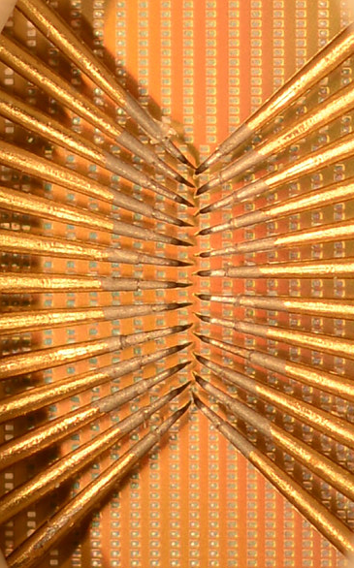
Test Structure Interface
Probe Card
1,3
2,3
3,3
4,3
5,3
6,3
Build Here
40 µm
1,2
2,2
3,2
4,2
Probe Here
6,2
40 µm
80 µm
1,1
2,1
3,1
4,1
5,1
6,1
60 µm

Slide 16
Basic Test Structure Forms
Precision Resistors
Diode Modules
Line
Resistance
Via
Resistance
MIM
Capacitor Modules
Transistor Arrays
MOSCAP Arrays
Overlap
MOSCAP Arrays
To Validation Modules

Slide 17
Modeling Validation Modules
From Parametric Modules
12 × 12 Inverter Array
1,024 Frequency Divider
10 Flipflops
V_{Ro}
V_{DD}
V_{DD}
Parametric Extraction
Q
Q_{n}
Q
Q_{n}
CLK
CLKn
CLK
CLKn
Q
Q_{n}
Q
Q_{n}
Model Parastics
CLK
CLKn
CLK
CLKn
W = 40 µm
Q
Q_{n}
Q
Q_{n}
CLK
CLKn
CLK
CLKn
Predict Oscillator Frequency
Q
Q_{n}
Q
Q_{n}
CLK
CLKn
CLK
CLKn
Q
Q_{n}
CLK
CLKn
Q
Q_{n}
Validate Performance
To EBL
CLK
CLKn
Ground
To Frequency Divider
Ground
Out
Ground
V
V
Close Timing in Real Circuit?
fast Pulses
slow Pulses

Slide 18
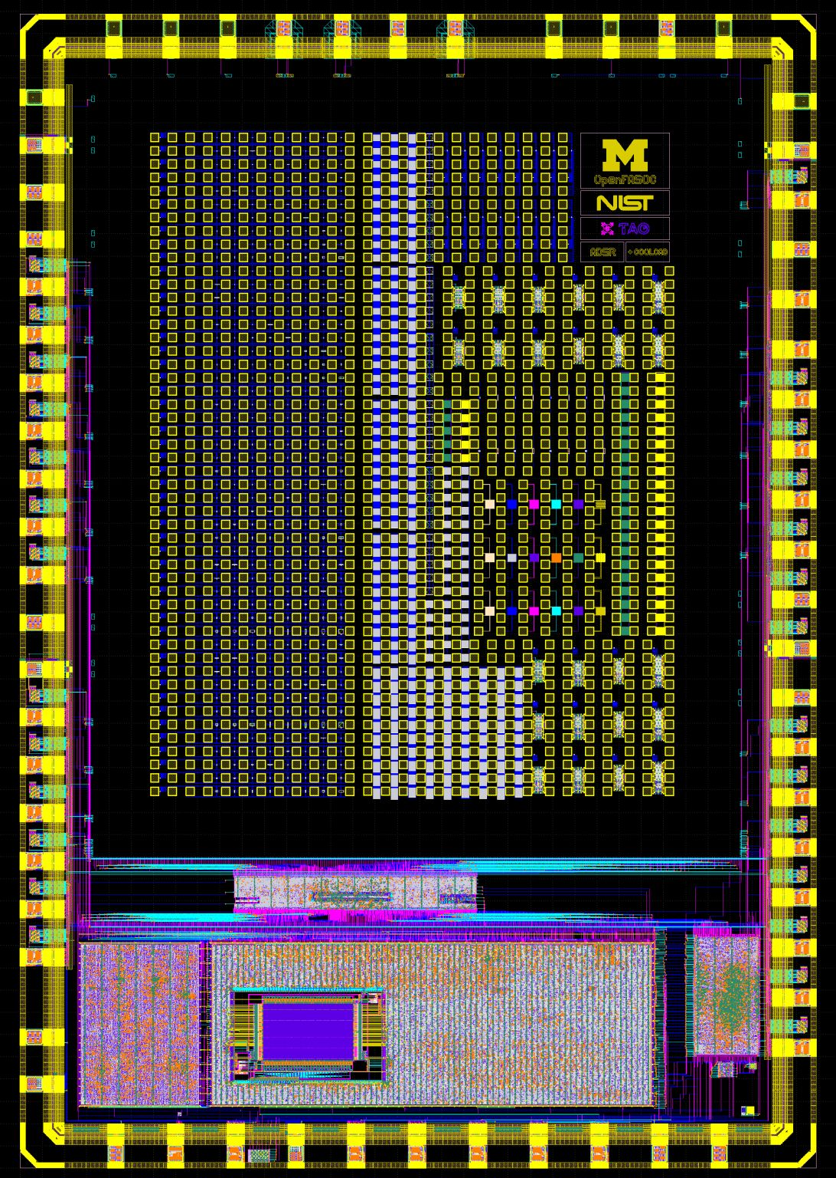
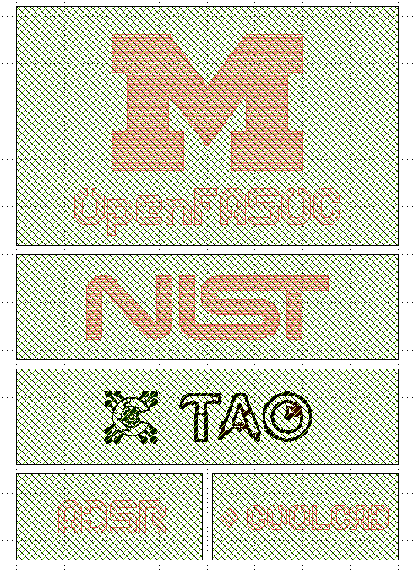
Resultant Test Die
Major Highlights!
Over 1400 Pads
400+ Transistor Structures
30 Capacitor Test Structures
24 Ring Oscillators
18 line and via chain modules
7 Diode Test Structures
https://github.com/tuohangzeng/openfasoc_cryo_caravel/tree/main/gds

Slide 19
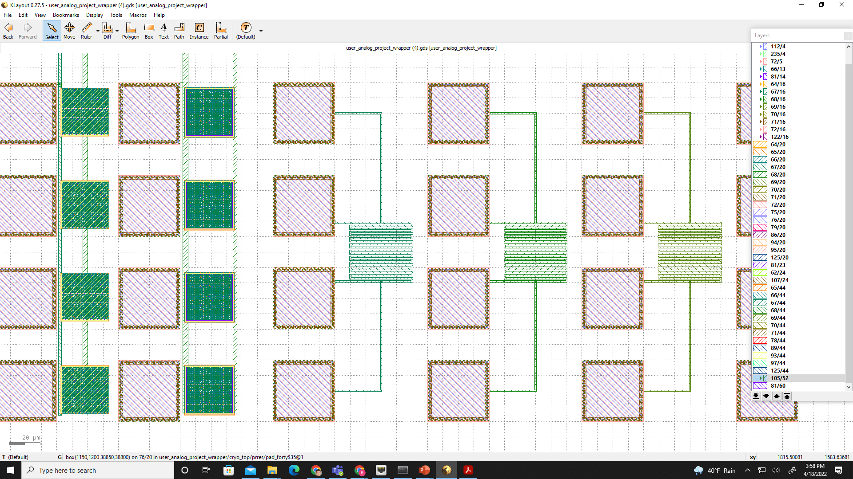
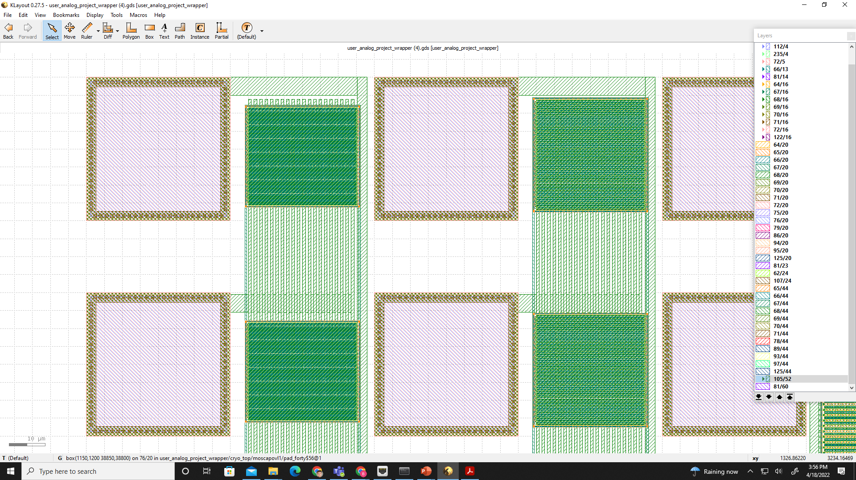
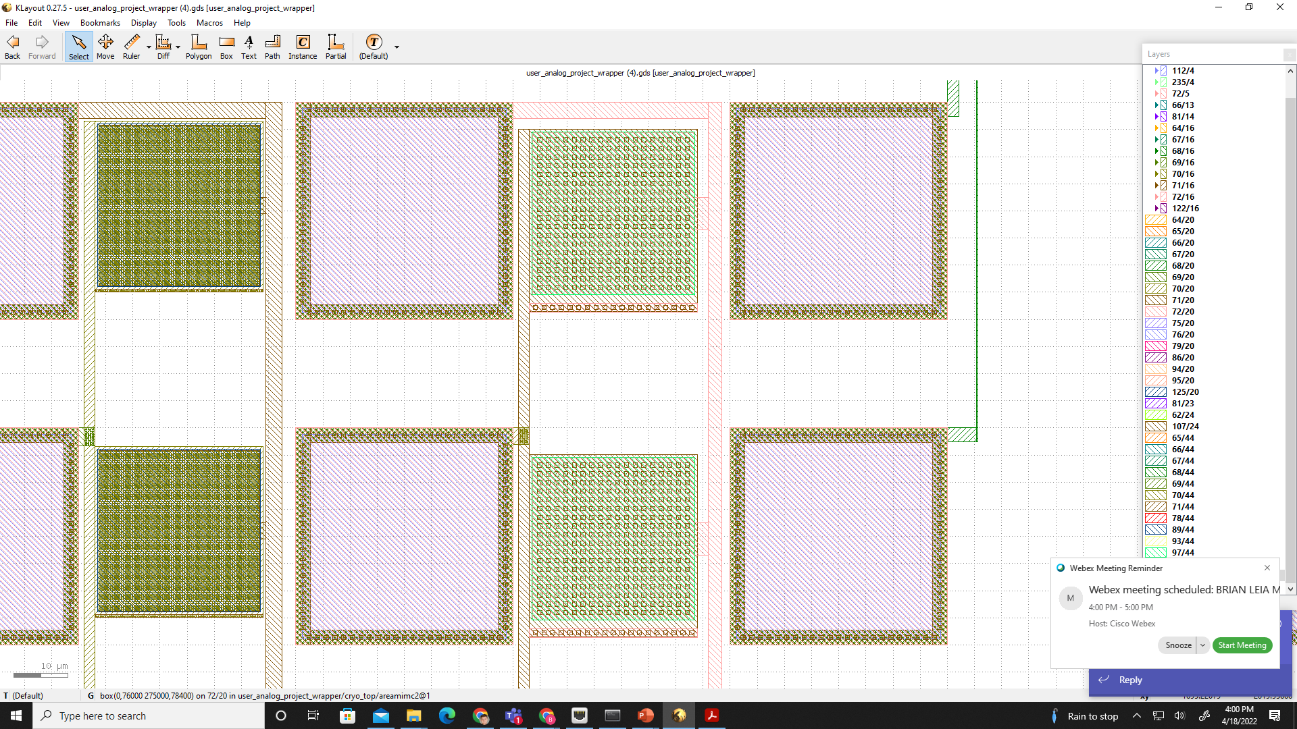
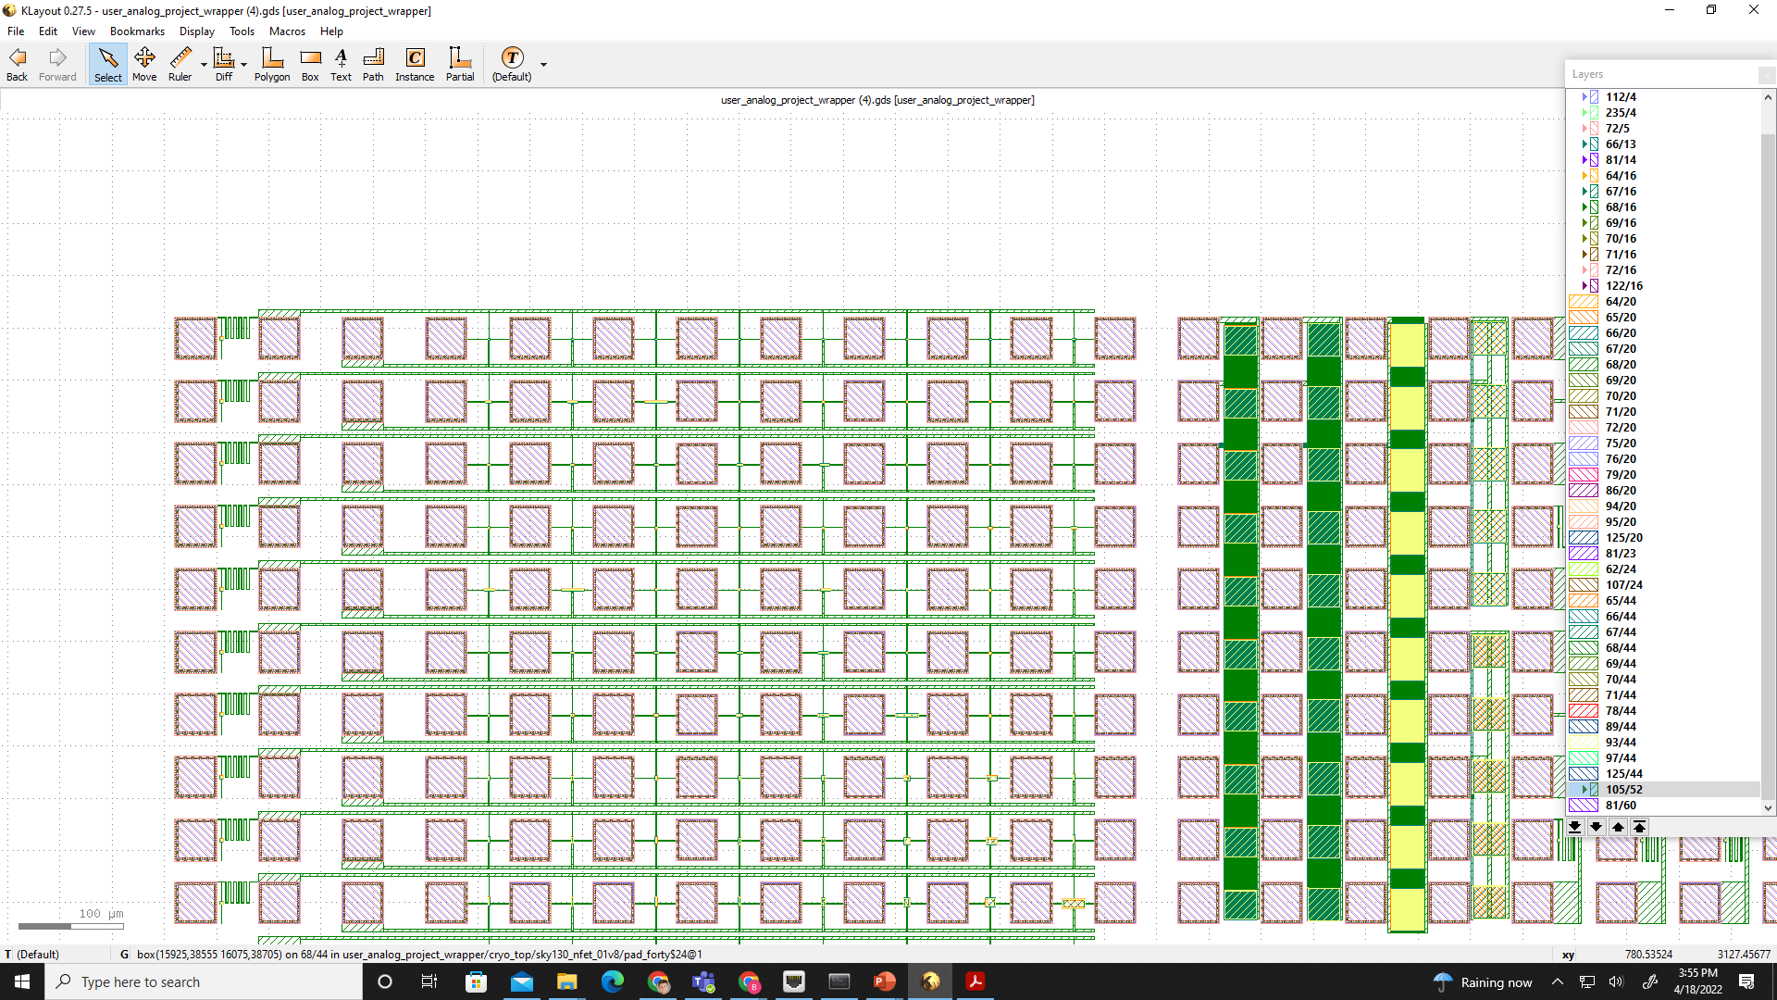
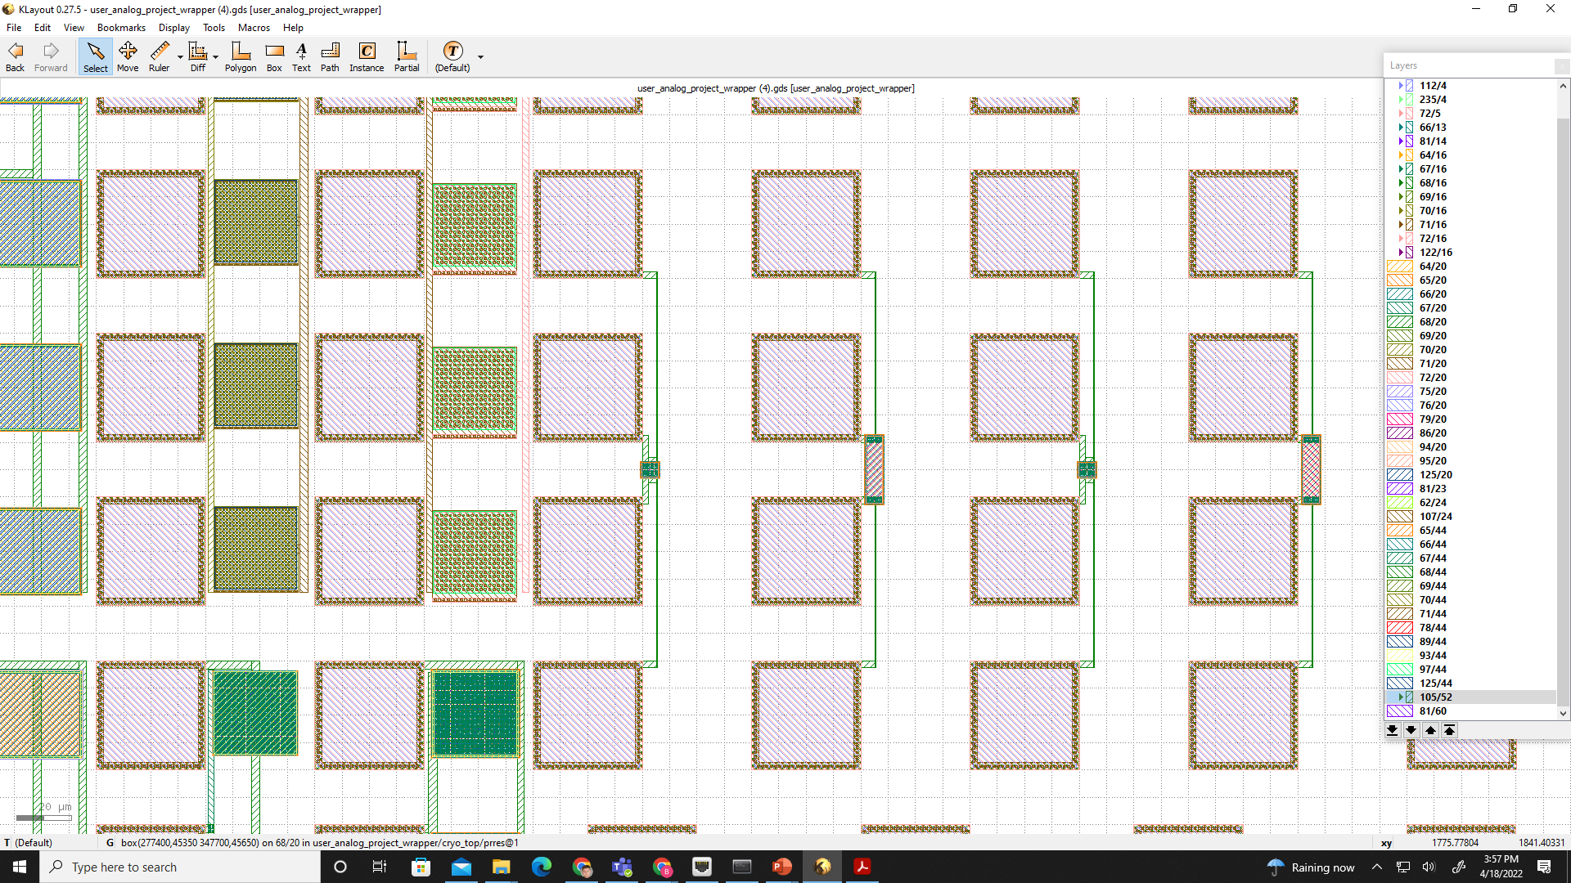
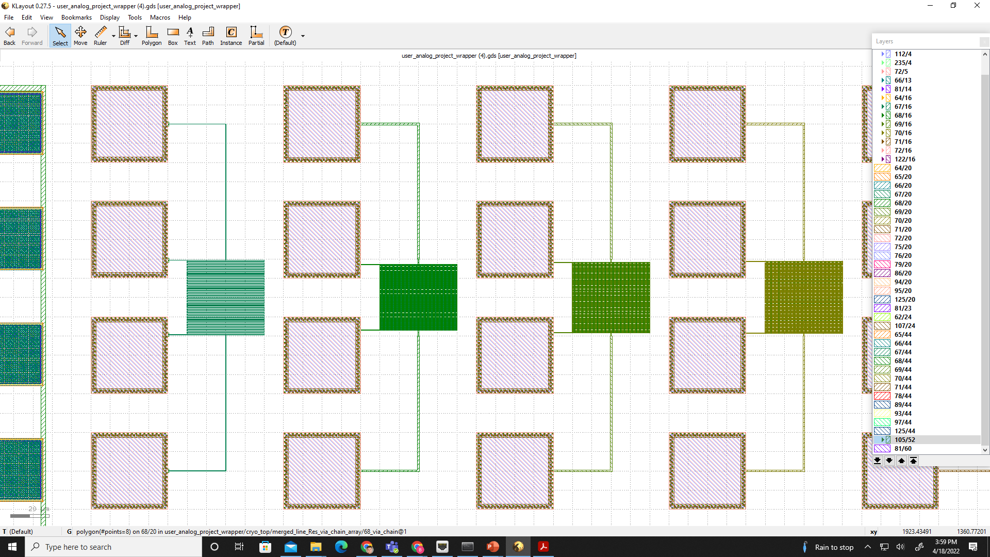
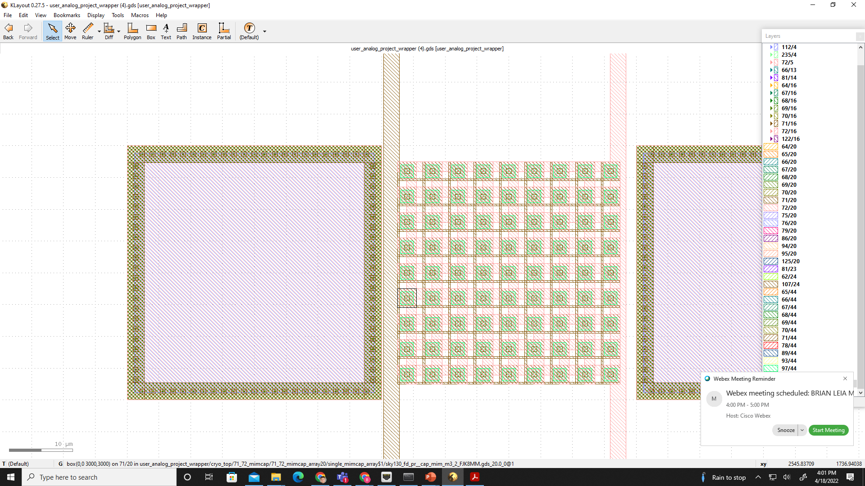
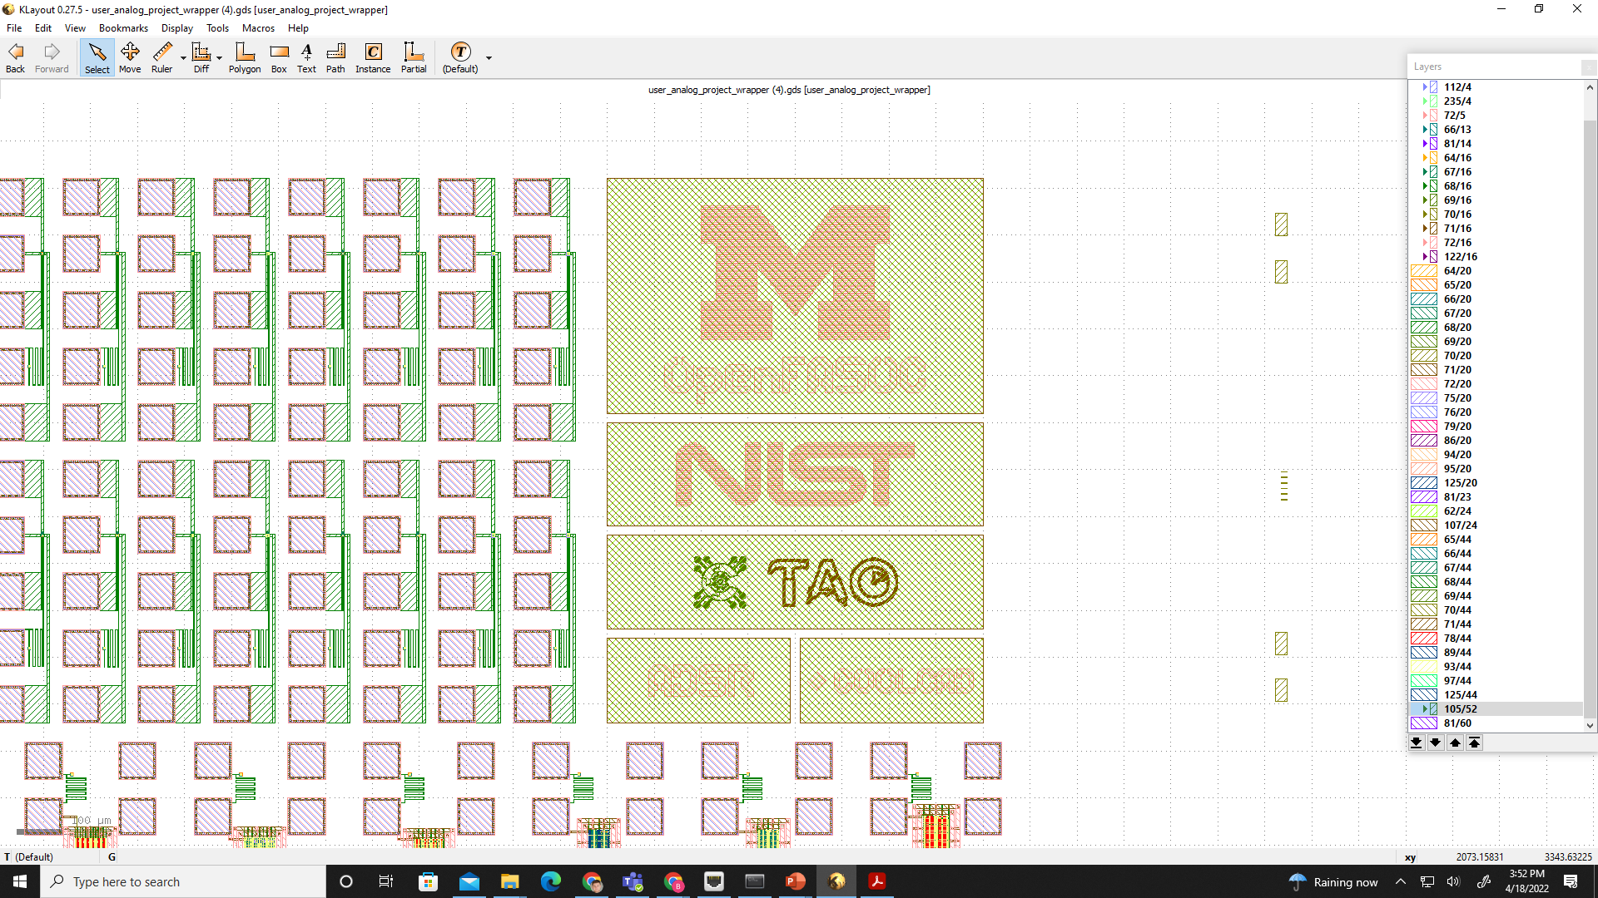
GDS Images
MOSCAP Arrays
Line Resistance
Diode Modules
Transistor Arrays
MIM
Capacitor Modules
Precision Resistors
Via Resistance

Slide 20
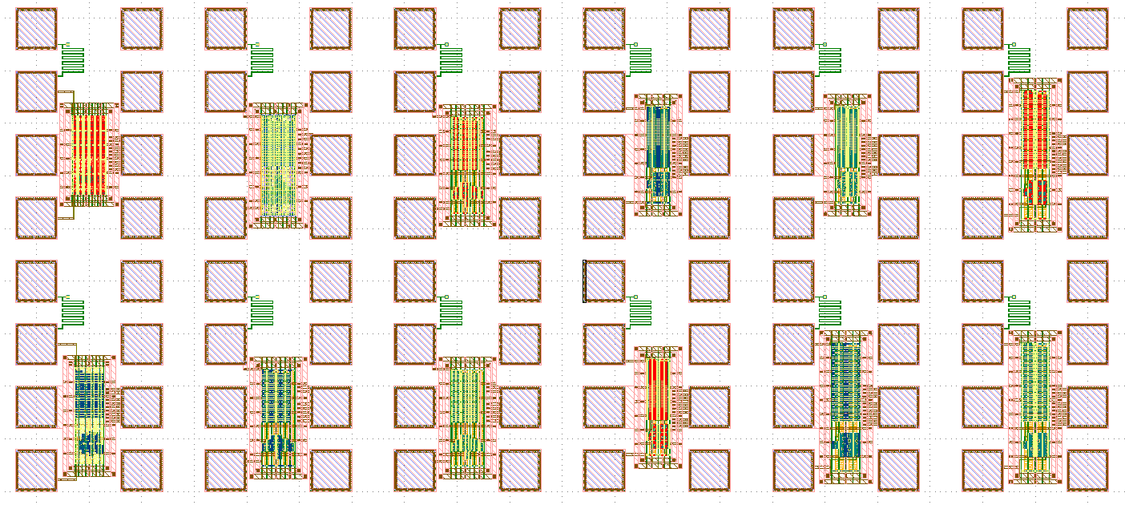
Validation Modules
Implemented 3 Standard Cell Inverter Classes:
HD, HS, and HVL inverters
9 Additional OSU Standard Cell Inverters
12T_hs, 12T_ls, 12T_ms,15T_hs,15T_Is, 15T_Is, 15T_ms, 18T_hs, 18T_Is, 18T_ms

Slide 21
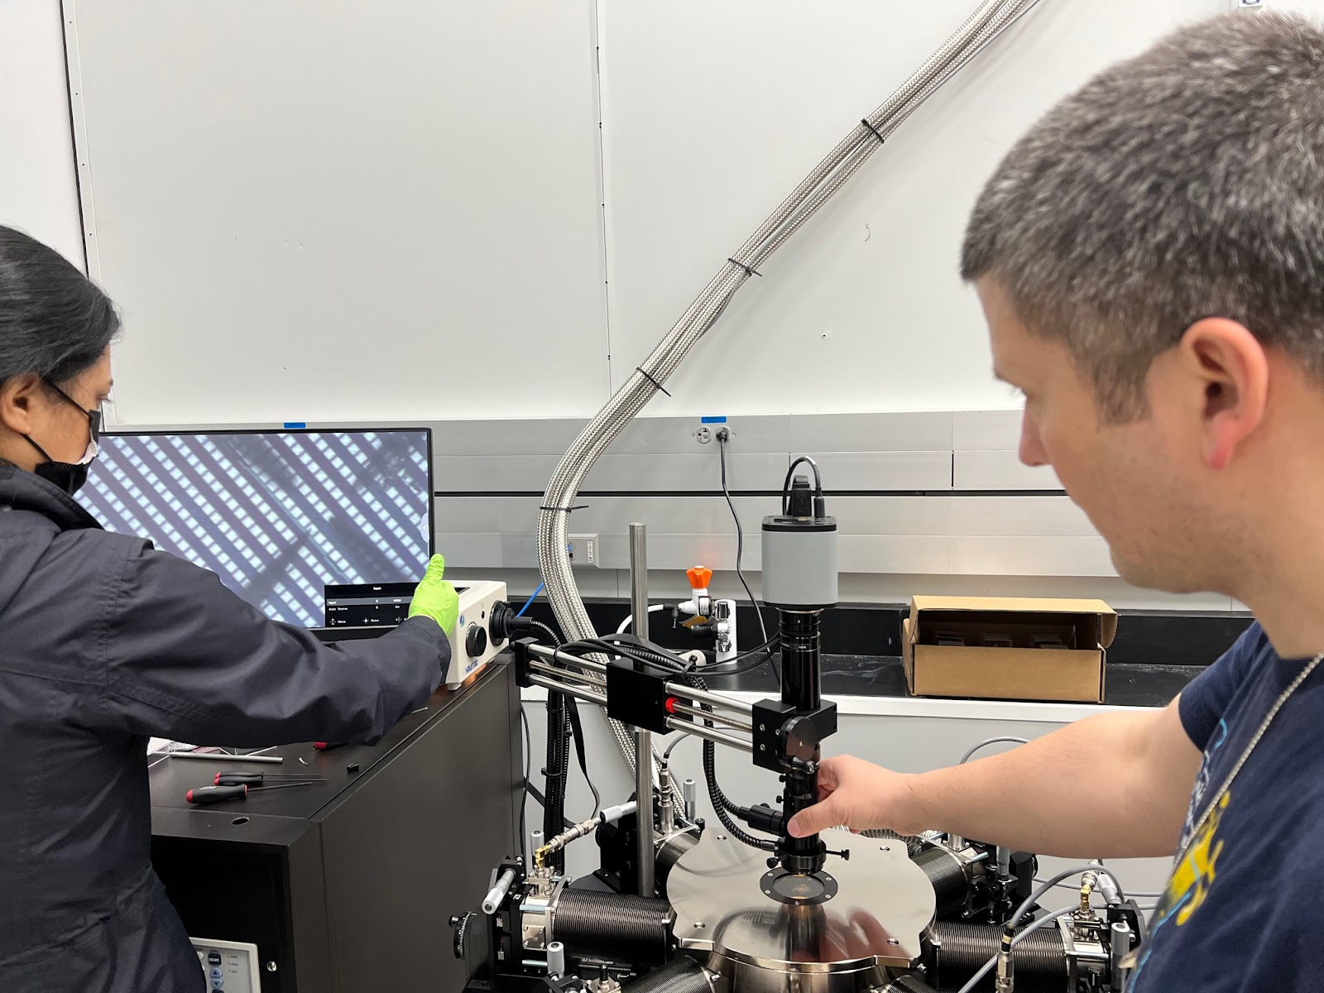
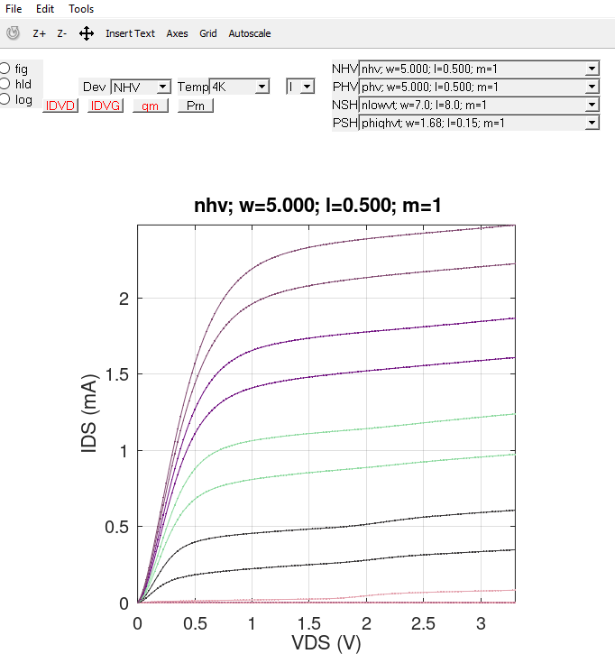
Preliminary Results: 118 Transistor @ 4k!

Slide 22

Cryogenic Electronics at NIST
Device
Circuits
Physics
Application Specific Reliability/understanding
Circuits
Standardize Testing
Packaging
Applications
Testing/Metrology

